Slide 1
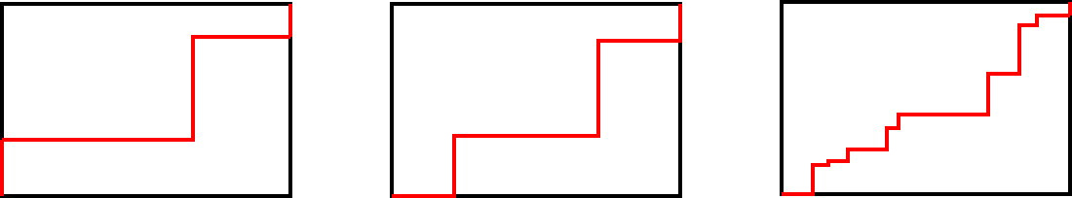


Perimeter with composite rectilinear shapes
Task A: Strange staircases
1) The perimeter of each rectangle is 26 cm.
How long is the red line each time?
a) b) c)
Justify your answer.
The red line is 13 cm long.
Let’s consider what would happen if all the vertical lines moved to the right and all the horizontal lines moved down. The red line is one length and one width of the rectangle. It is half the perimeter.
Task B: More composite rectilinear shapes
2
4
3
3
6
3
6
8
8
1) Try to rearrange these sides to create a rectangle.
Evaluate how easy this is to do.

Slide 2

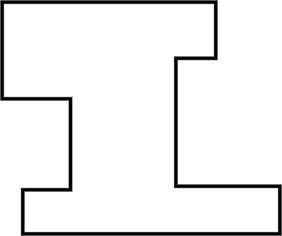
Perimeter with composite rectilinear shapes
Task C: Perimeter calculations
1) Calculate the perimeter.
a) b)
17
11.1 m
2
3.2 m
23
14
0.6 m
2
5
19
Perimeter = 2 × (11.1 + 0.6 + 3.2)
= 29.8 m
Perimeter = 23 × 2 + 17 + 2 + 5 + 19 + 2 + 3
= 94 units
Mathematics in Education and Industry.

